Slide 1

Things that make us different:
early life events, psychotic experiences, face recognition abilities
Nicholas Furl
Royal Holloway, University of London
Birkbeck Psychology, 22nd May 2024

Slide 2


Things that make us different:
early life events, psychotic experiences, face recognition abilities
Alex Lloyd
Ryan McKay

Slide 3
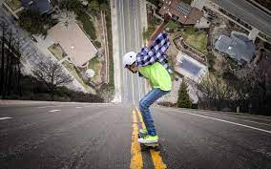

Can experiences during adolescence affect decisions in adulthood?
During development (adolescence), enhanced cognitive flexibility leads to exploratory behaviours so naive individual can learn about environment
Decision strategies then crystalise during adulthood, leading to reduced need for exploration & reduced cognitive flexibility

Slide 4

Exploration: patch foraging
Agents harvest apples (rewards) from trees (patches)
Patch deplete rewards from initial richness
After each harvest, agent chooses:
Harvest again
Move to new patch (with cost)
How low will you go?
Leave threshold: Reward level when agent leaves patch
Higher = explore, lower = exploit

Slide 5
Exploration: modelling
Marginal value theorem
Optimal leave threshold
reward < background reward rate
Reinforcement learning
Learn background reward rate
Learning rate
How much can each harvest change background reward rate?
Estimated from participant data

Slide 6
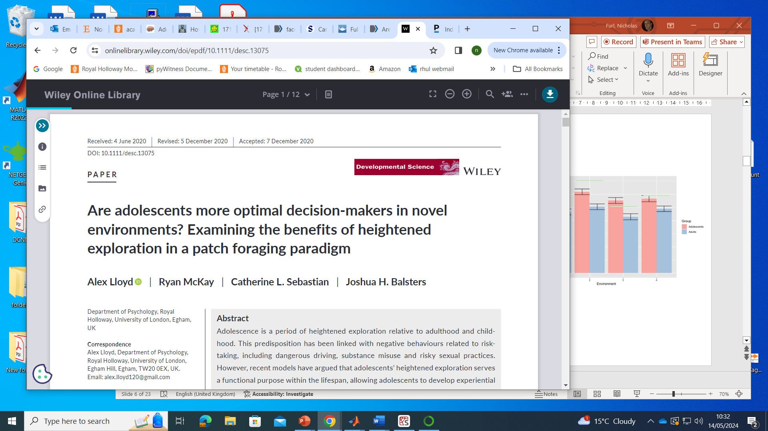

Previous finding:
adults overexploit while adolescents explore more optimally
Adolescence is a naïve period of exploration
Adults exploit / act on existing knowledge - even to a fault!
Optimal threshold
More exploration

Slide 7

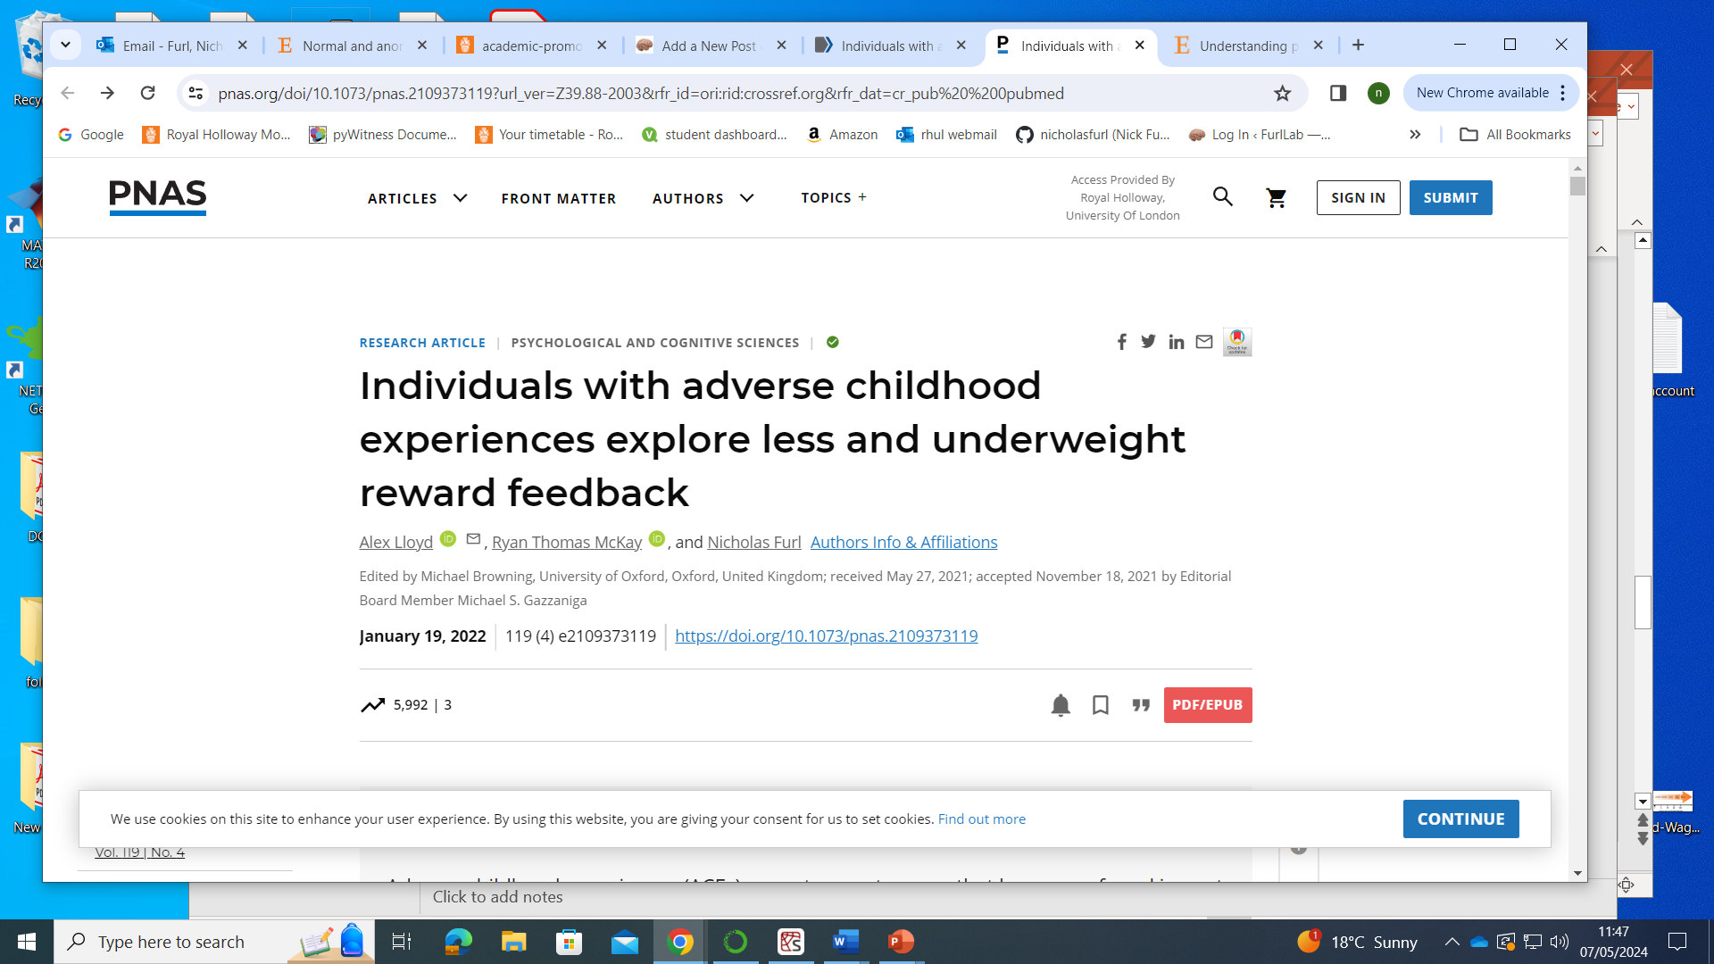
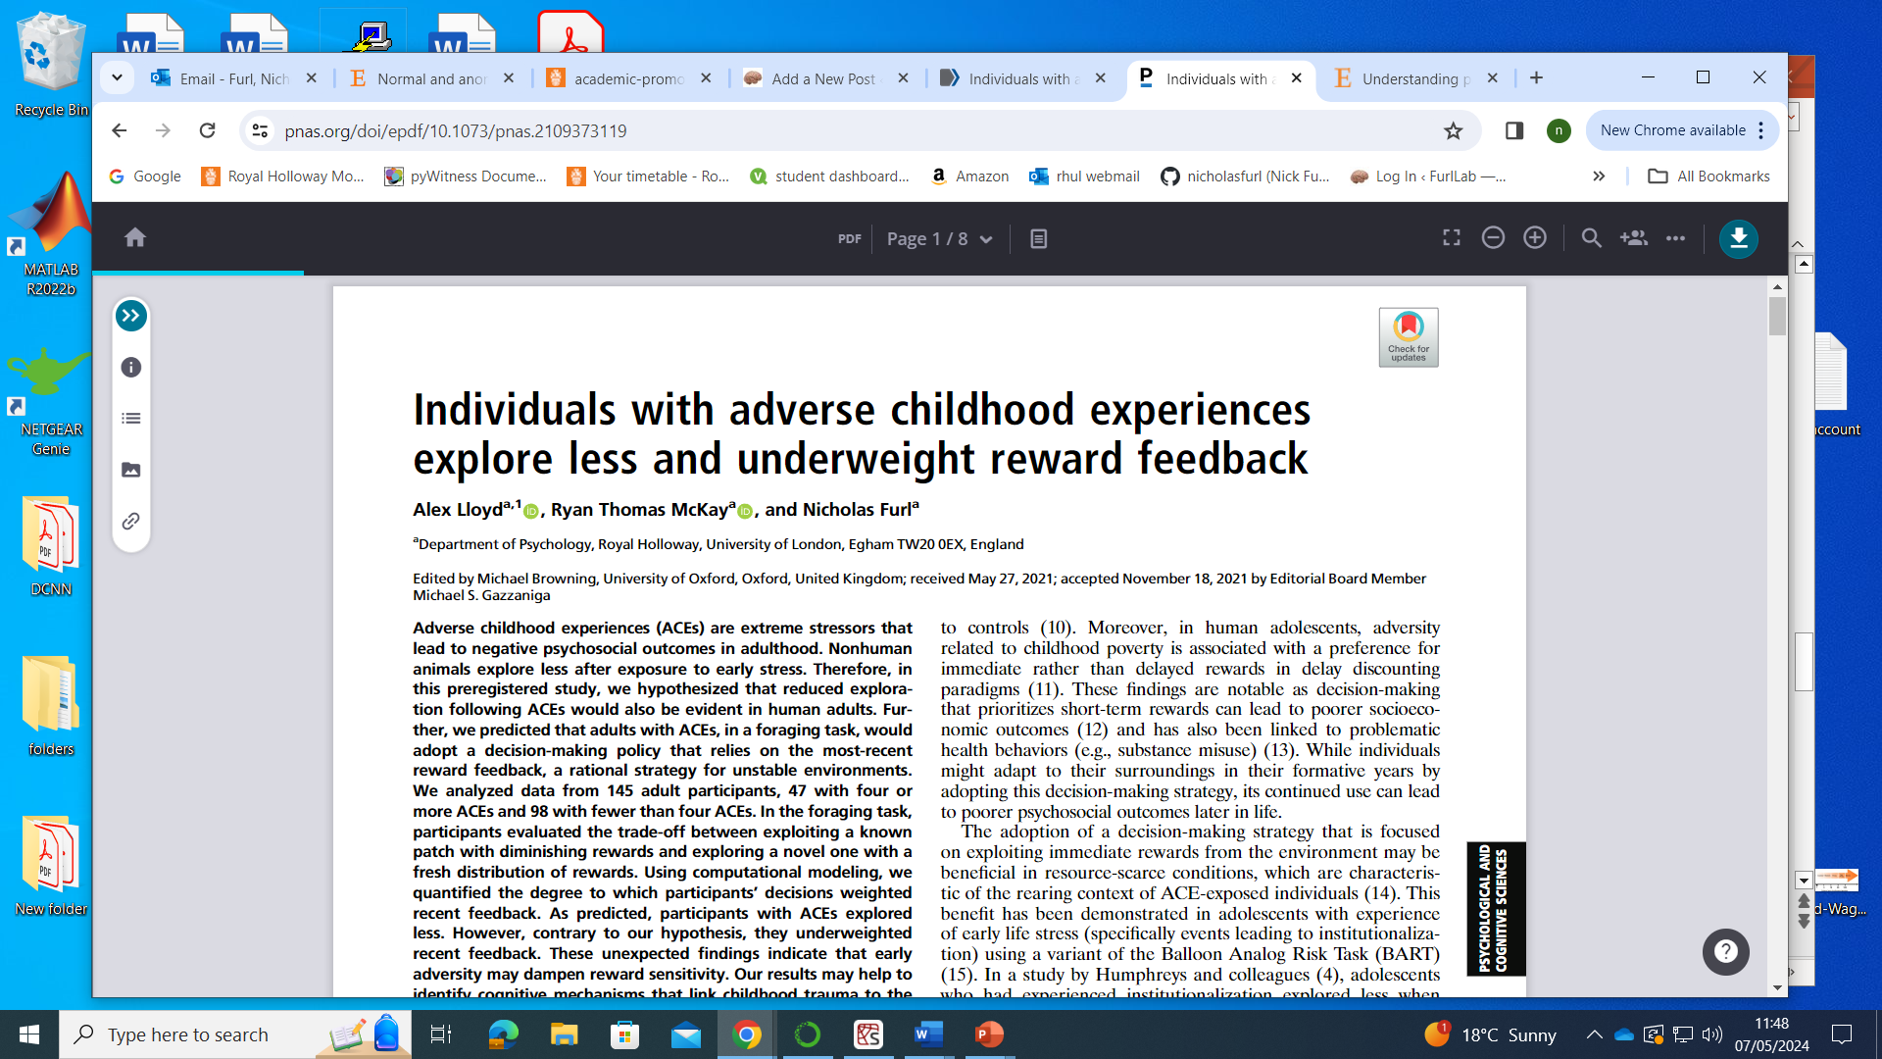
Will adults with ACEs adopt foraging strategies that depend on childhood learning?
Participants enrolled from various charities for survivors of trauma, SONA university students, Prolific
47 participants with >4 adverse childhood events (ACEs)
98 participants with fewer ACEs

Slide 8
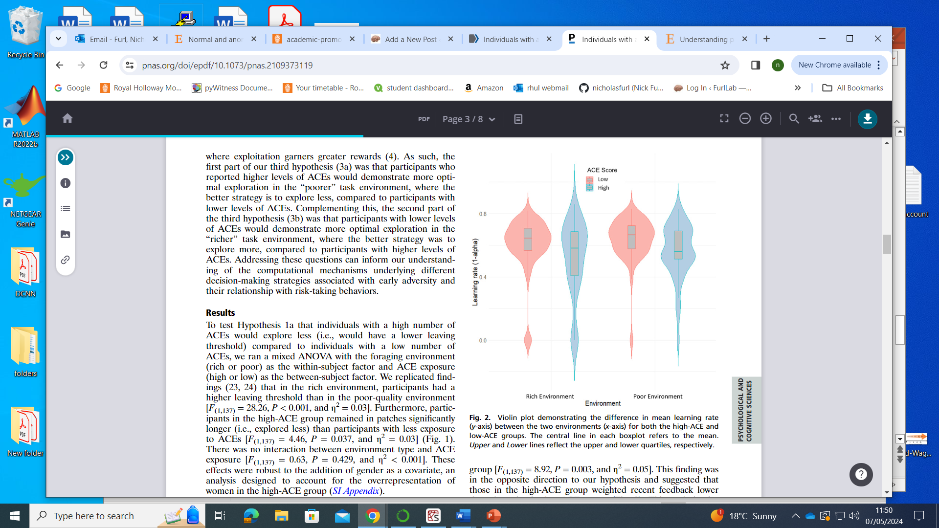
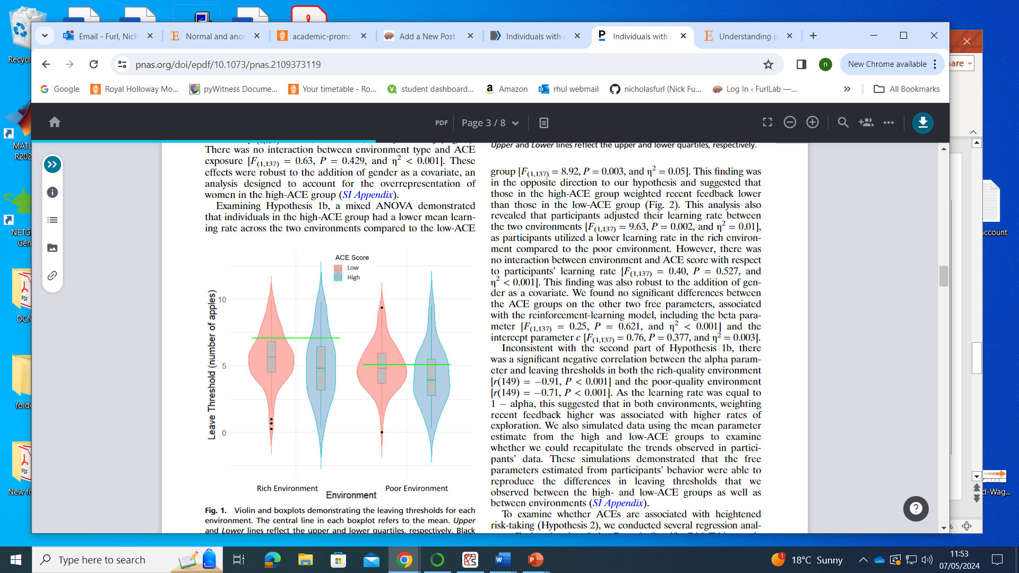
Participants with ACEs ….
Optimal threshold
More exploration
Faster reward learning
….. explore less & less optimally
…. Learn from rewards more slowly

Slide 9
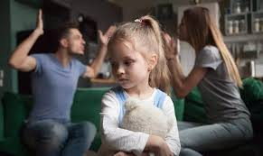
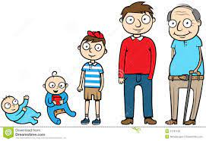
Conclusions
Adolescence is a naïve period of exploration, which can determine strategies used by (less exploratory) adults
Adults with ACE’s learn strategies adapted to unstable / unpredictable environments, which then generalise to adult environments
As children with ACEs mature, their experiences during development lead to them explore less and to become relatively insensitive to rewards, compared to other adults

Slide 10
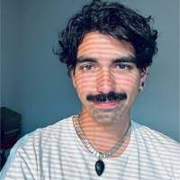
Things that make us different:
early life events, psychotic experiences, face recognition abilities
Francesco Scaramozzino
Ryan McKay

Slide 11


Understanding why people have delusion-like means understanding the mechanisms behind belief

Slide 12
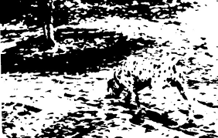

Evidence accumulation
Beliefs arise from interactions between top-down & bottom-up information
Bayesian models quantify these concepts as posterior, prior & likelihood / evidence

Slide 13
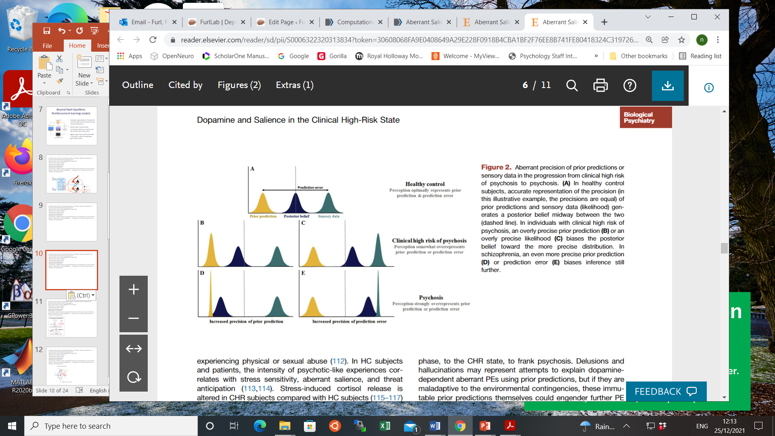

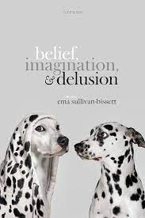

Evidence accumulation in psychosis
Evidence too precise
bizarre beliefs adopted to explain random events
prior
evidence

Slide 14
Are subclinical delusion-like & hallucination-like experiences in the general population related to more precise sensory evidence?

Slide 15
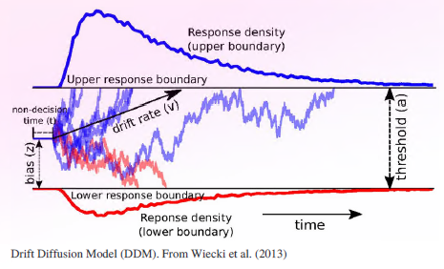
Quantifying precision on evidence
Hierarchical drift diffusion model
Fitted to reaction times & responses
Decision threshold ~ amount of evidence needed
Drift rate ~ sensory evidence precision

Slide 16
Quantifying precision on evidence
Hierarchical drift diffusion model
Fitted to reaction times & responses
Decision threshold ~ amount of evidence needed
Drift rate ~ sensory evidence precision
Will individuals with psychosis-like experiences show higher drift rates?
Beliefs more quickly / easily swayed by sensory evidence
prior
evidence

Slide 17
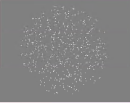
Random dot motion task
Classic perceptual evidence accumulation task
Posterior parietal cortex in monkeys well-known to accumulate evidence about motion direction
Proportion of dots moves coherently left or right while other dots random
High (easy) & low (difficult) coherence

Slide 18
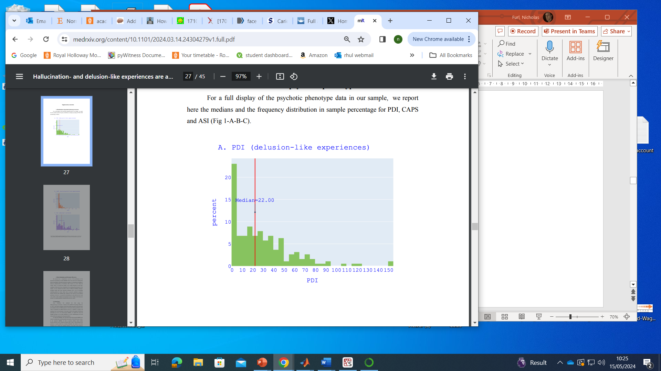
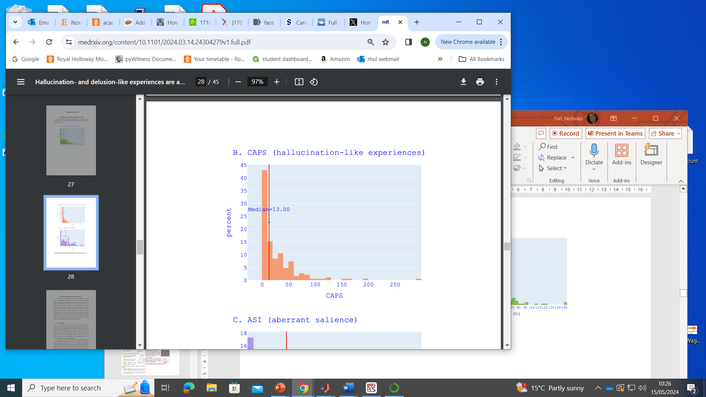

Study 1
N = 194
Peters Delusion Inventory (PDI)
Cardiff anomalous perception scale (CAPS)
Median split groups

Slide 19
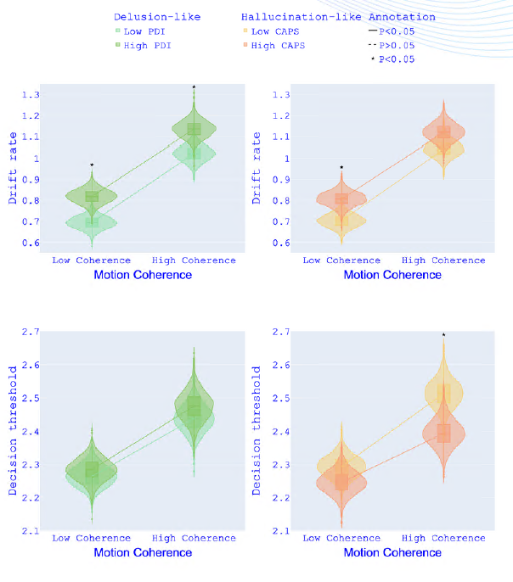
Study 1 results
Partial evidence for CAPS & increased drift rate
PDI & increased drift rate
No evidence PDI relates to threshold
Partial evidence for CAPS & increased threshold

Slide 20
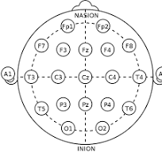
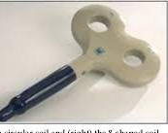
Study 2
Posterior parietal cortex in monkeys well-known to accumulate evidence about motion direction
N = 68, median split based on PDI, CAPS
Repetitive transcranial stimulation (TMS)
Offline 15 minutes of repetitive low-frequency (1 Hz) over P4 for 15 minutes
Sham (coil flipped)

Slide 21
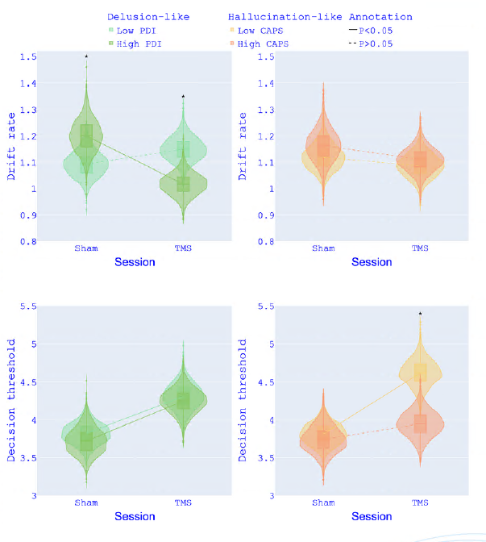
Study 2 results
Larger drift rate for high PDI replicates & eliminated by TMS
No evidence CAPS relates to drift rate
No evidence PDI relates to threshold
Larger threshold for high CAPS increased by TMS

Slide 22
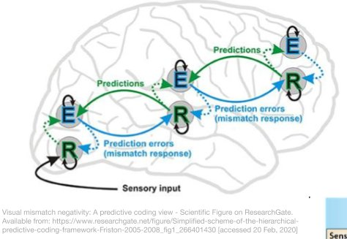
Conclusions
Replicated link between delusion proneness & drift rates
Hasty / impulsive evidence accumulation due to oversensitivity to evidence
PPC (known to accumulate decision variable) causally involved
Predictive coding & psychosis prone-ness
Delusions, hallucinations arise from overly precise evidence
Ordinary experiences give rise to spurious prediction error, driving bizarre beliefs to explain “aberrant salience”

Slide 23

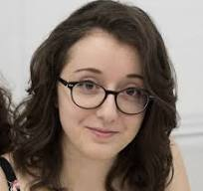


Things that make us different:
early life events, psychotic experiences, face recognition abilities
Gaia Giampietro
Thora Bjornsdottir
Laura Mickes
Ryan McKay

Slide 24
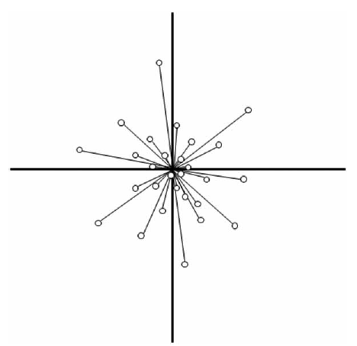
Features are dimensions
Faces vary on independent dimensions
e.g., distance between eyes, nose size
Each dimension is axis in multidimensional space
Each face is coordinate in the space
A list of values of each feature
Big noses
Eyes close together
Eyes far apart
Small noses

Slide 25
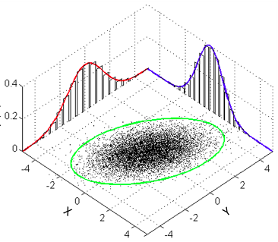
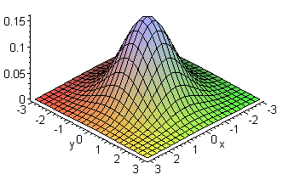
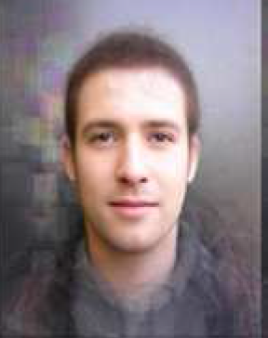
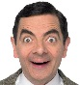
Face space predicts distinctiveness effects
Typical faces
Densely packed together around average
Like many other faces
Highly confusable
Less accuracy
Distinctive faces
Alone in space
Cannot easily confuse faces
More accurate

Slide 26
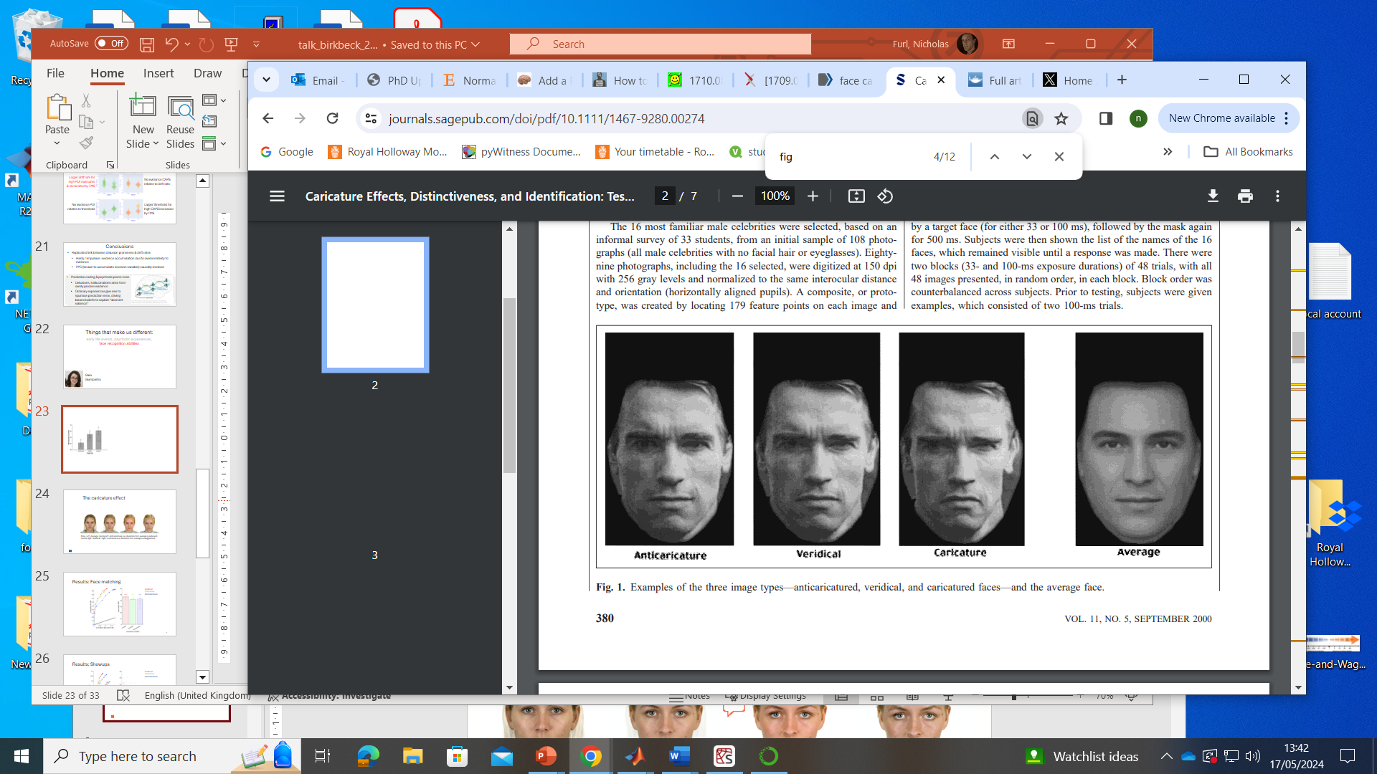
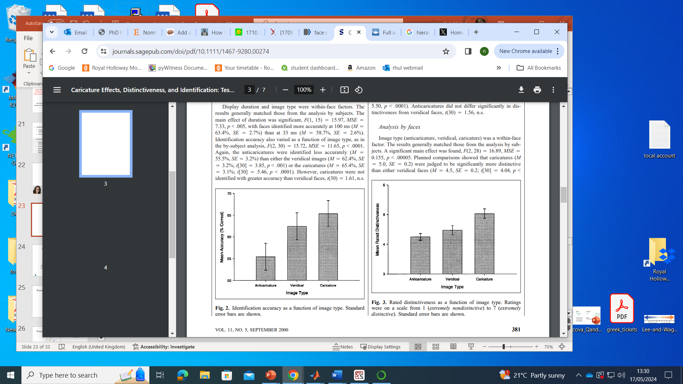

Superportrait effect
Faces learned as veridical should be recognised more accurately if caricatured
Caricatured test Swartzenegger better recognised because it is “more Swartzenegger” than the learned veridical version

Slide 27
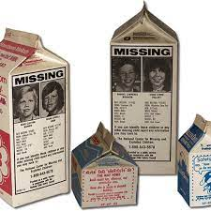
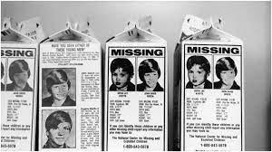
Useful for forensic contexts?
Eyewitness lineups? Matching IDs (e.g., border security, etc)
Missing children
If you see a caricatured image, you might recognise a face seen as veridical earlier or later
Relatively little face recognition studies on children’s faces
Ask me later about our eyewitness lineup studies using adult caricatures

Slide 28
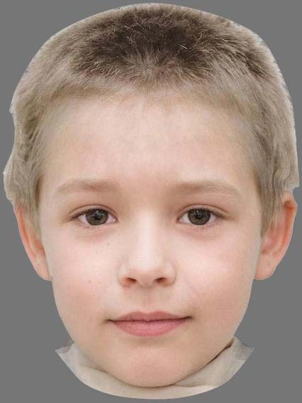
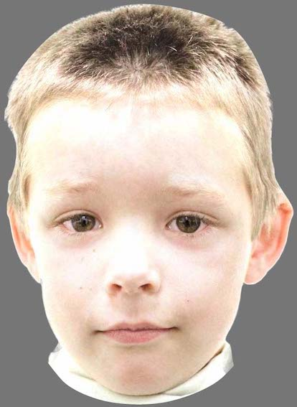
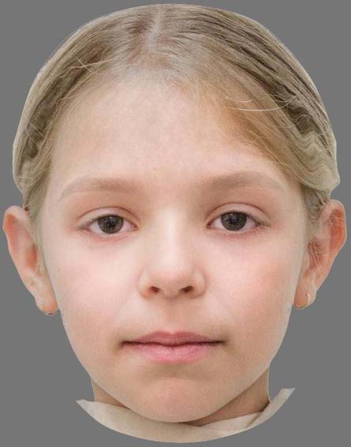
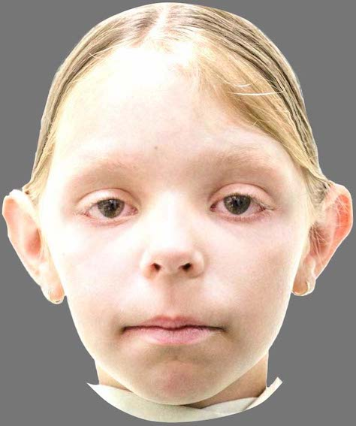
Old / new recognition for children’s faces
CFMT+: Diagnostic test for assessing individual differences in facial recognition ability
400 enrolled participants
19 low recognisers > 2 SD below mean CFMT+
20 super recognisers > 2 SD above mean CFMT+
361 typical recognisers
Compared performance to a computational face space ….
Anticaricature
Caricature

Slide 29
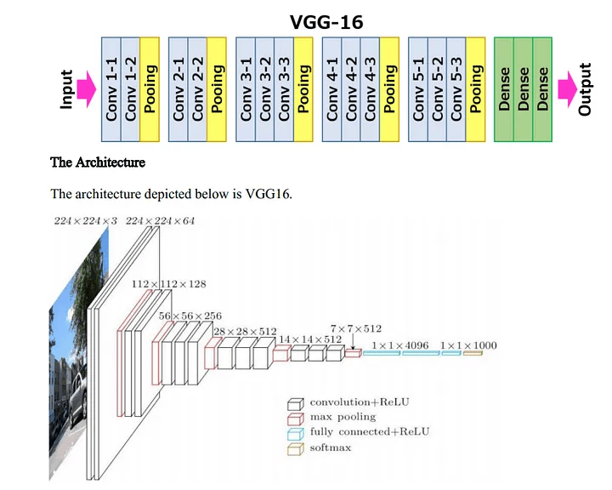
Computational face space
Transfer learning in convolutional deep neutral networks
Project our faces onto dimensions of “highest level” of pretrained model to extract positions in “face space”, compute dissimilarity distances between faces
cf. Muhammad Abdullah Arif Medium
https://tinyurl.com/yc5sxees

Slide 30
Computational face space
Vgg16
trained on Imagenet dataset
32,326 images broken down into 1,000 categories
SENet
SE-ResNet-50 trained in vggFACE2
3.31 million images of 9131 subjects, with an average of 362.6 images for each subject
cf. Muhammad Abdullah Arif Medium
https://tinyurl.com/yc5sxees

Slide 31
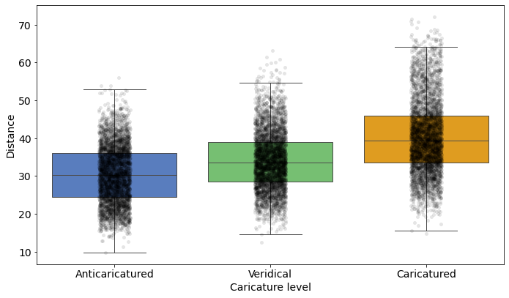
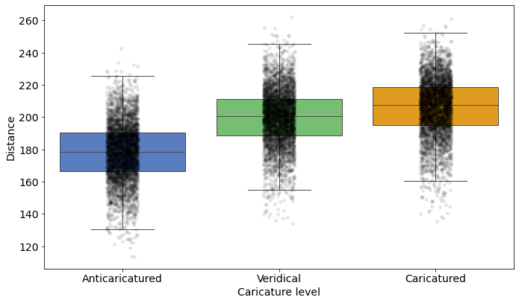
Caricature spreads out faces in face space
Imagenet vgg16
VggFACE2 SENet

Slide 32
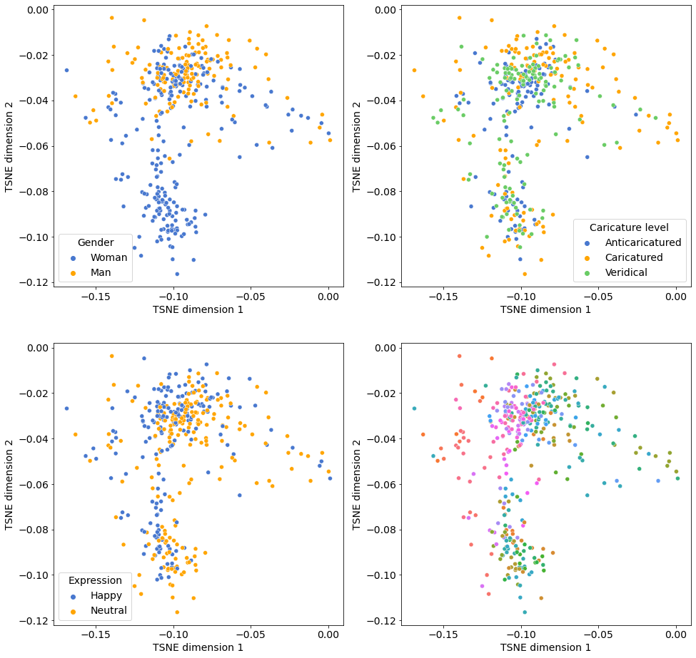
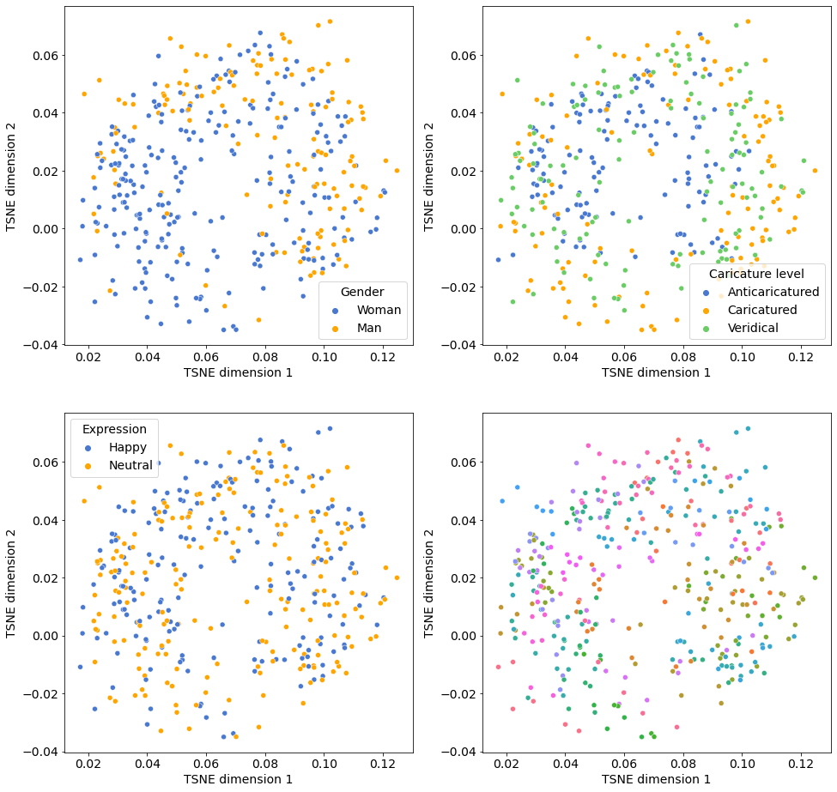
Caricature spreads out faces in face space
Imagenet vgg16
VggFACE2 SENet

Slide 33
Simulating old / new recognition
Create 400 simulated participants, each with same numbers of trials as experiment, populated with randomly selected faces
Euclidean distances between test faces & nearest study face
Old faces: shorter distances to study face means more hits
New faces: longer distances to study face means fewer false alarms
Sweep a decision criterion across distances
Distances < criterion: “old” response

Slide 34
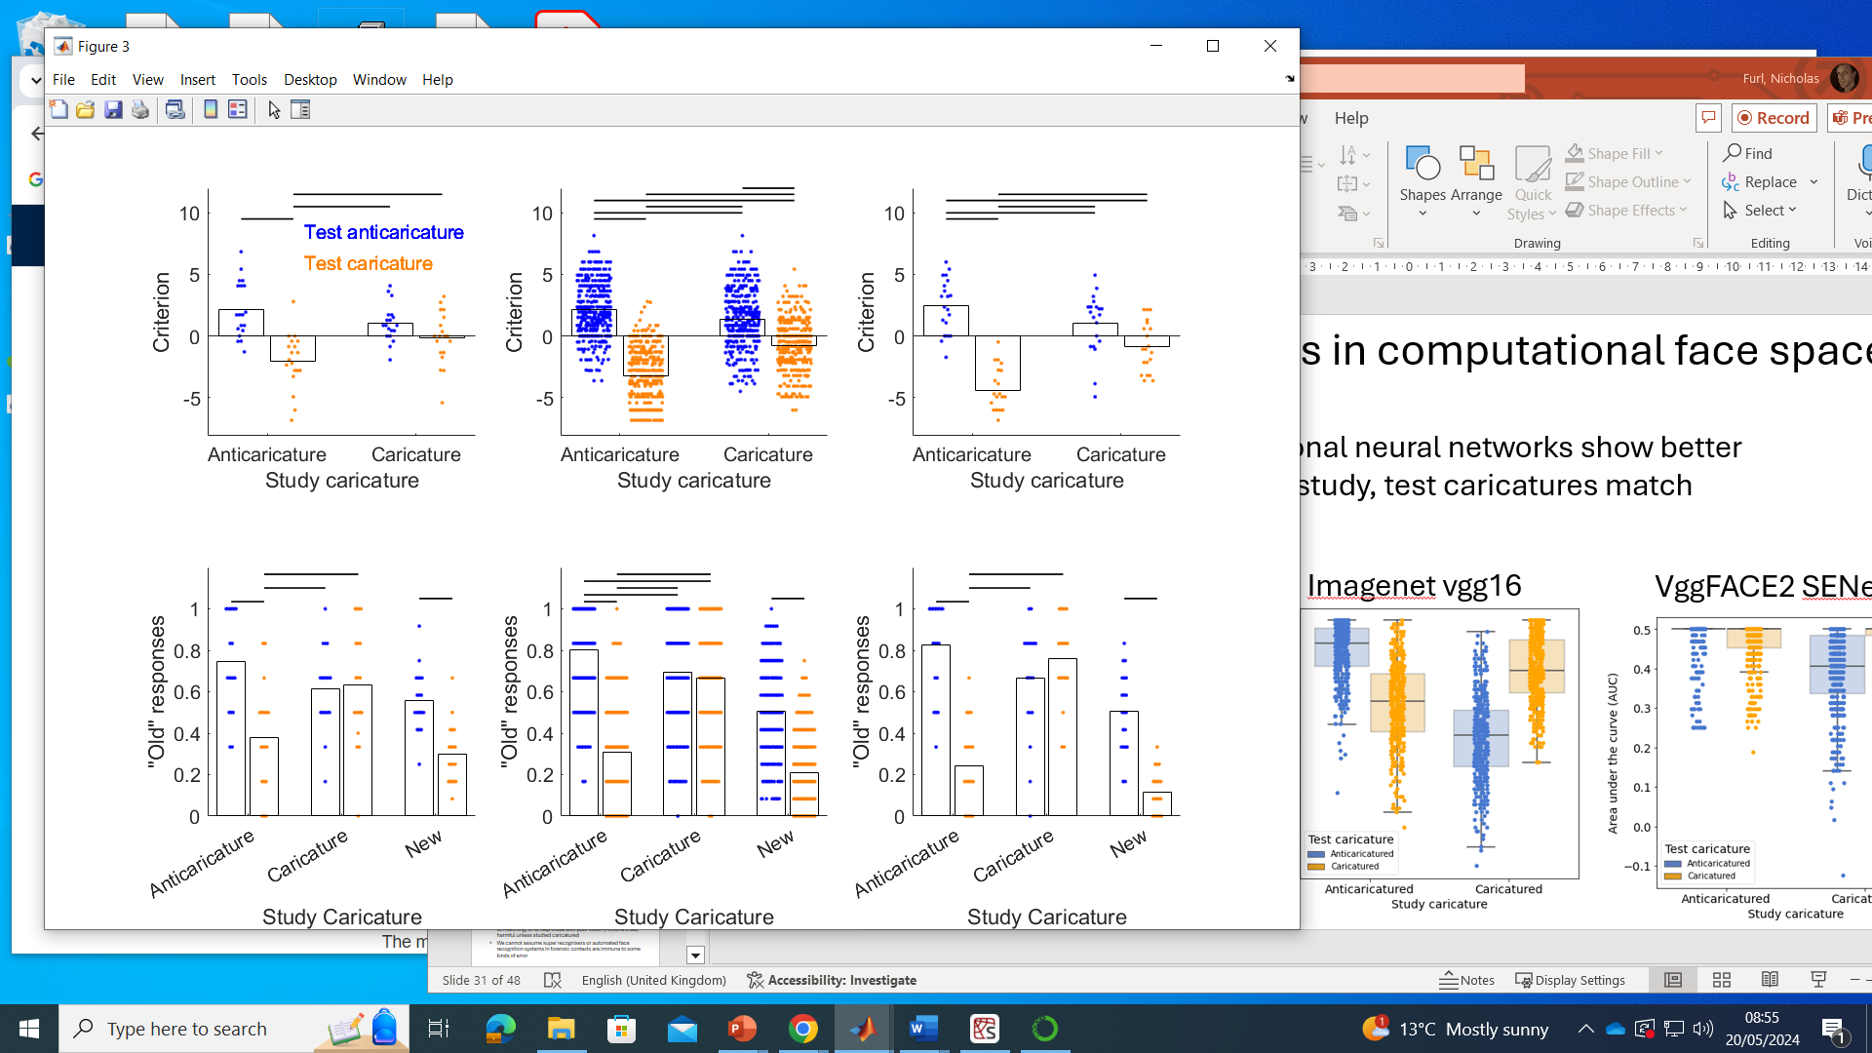
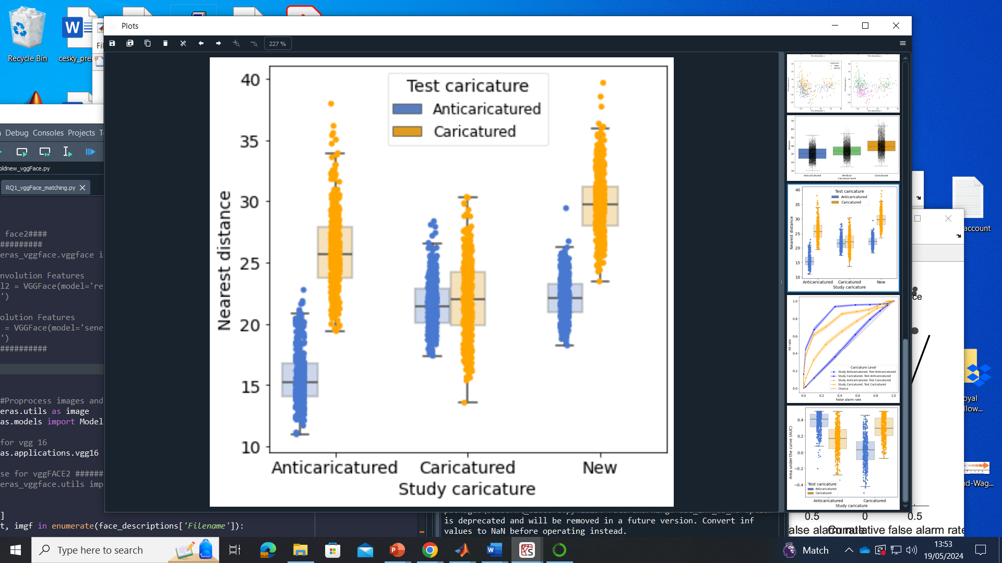
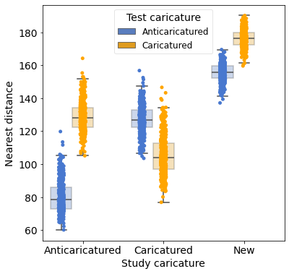
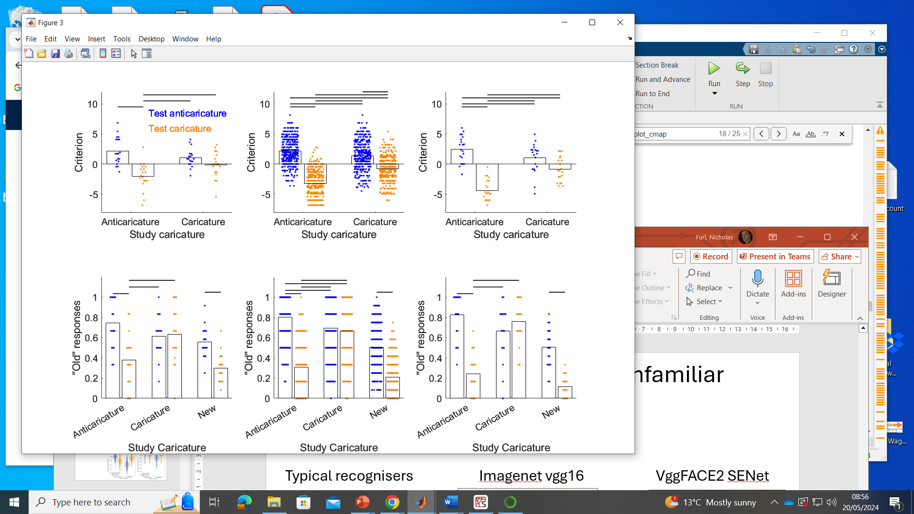
Are there super portrait effects?
No, hit rate suffers when caricature increased at test
Caricature of new faces improves false alarms
Model distances mirror human “old” judgements
Typical recognisers
Imagenet vgg16
VggFACE2 SENet

Slide 35
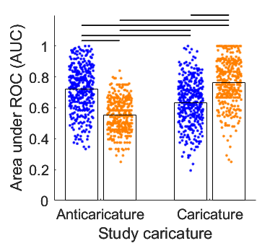
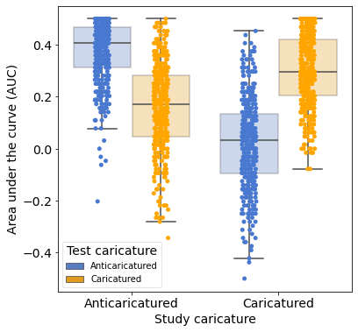
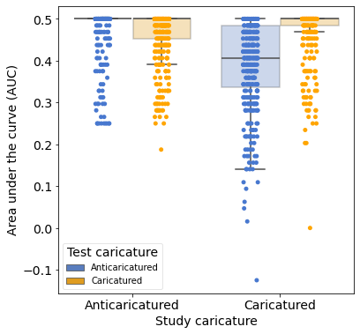
Are there super portrait effects?
No, deep convolutional neural networks show better performance when study, test caricatures match
Typical recognisers
Imagenet vgg16
VggFACE2 SENet

Slide 36
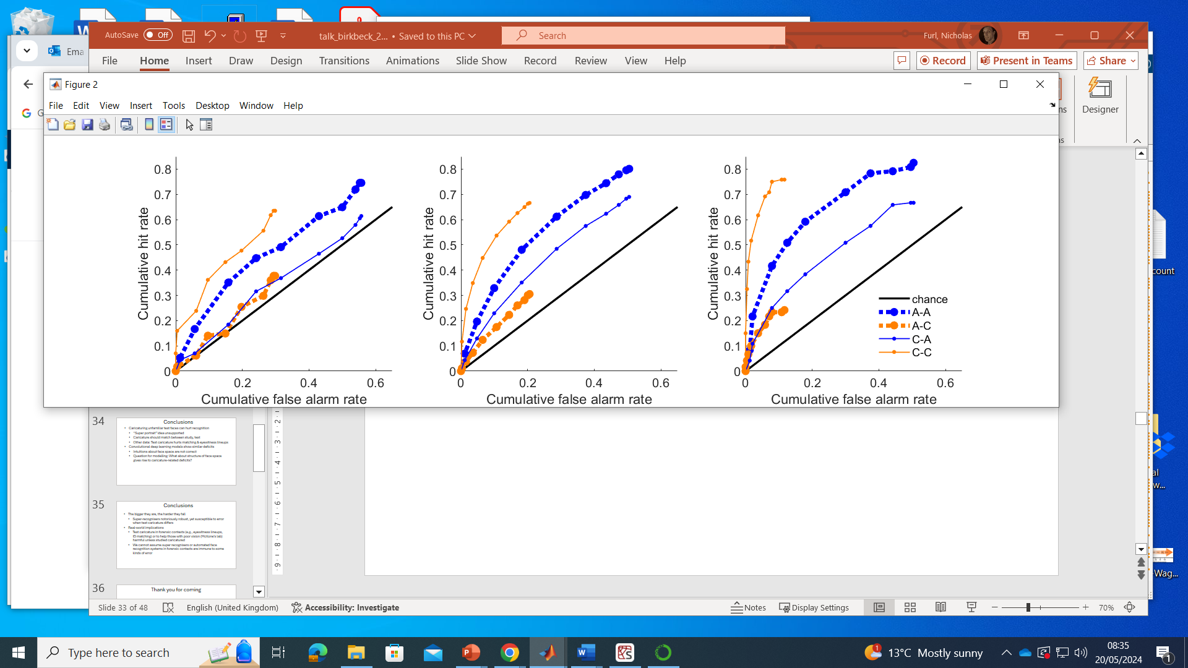
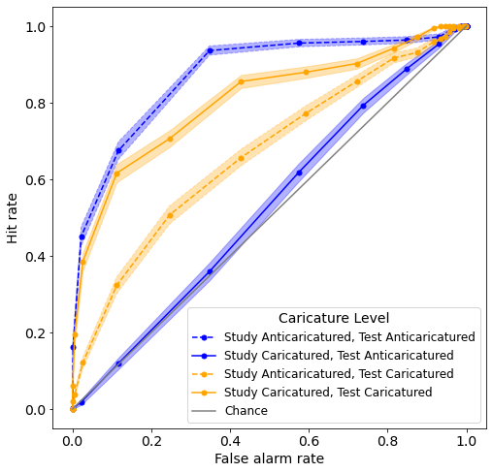
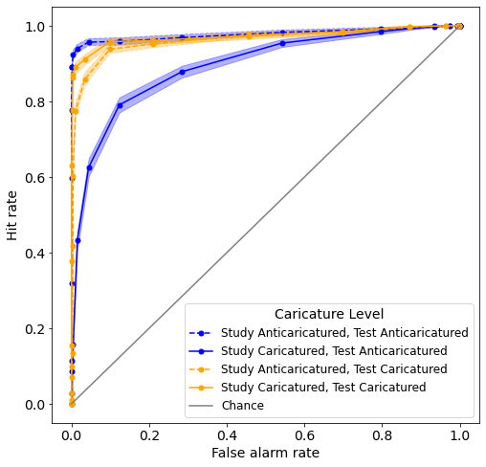
Are there super portrait effects?
No, deep convolutional neural networks show better performance when study, test caricatures match
Typical recognisers
Imagenet vgg16
VggFACE2 SENet

Slide 37
Is super recognition ability protective?
Super recognisers enhanced in conditions with matching caricature (C-C, A-A), but still make errors when mismatched (C-A, A-C)
Low recognisers
Typical recognisers
Super recognisers

Slide 38
Conclusions
Caricaturing unfamiliar test faces can hurt recognition
“Super portrait” idea unsupported
Caricature should match between study, test
Other data: Test caricature hurts matching & eyewitness lineups
Convolutional deep learning models show similar deficits
Intuitions about face space are not correct
Question for modelling: What about structure of face space gives rise to caricature-related deficits?

Slide 39
Conclusions
The bigger they are, the harder they fall
Super-recognisers notoriously robust, yet susceptible to error when test caricature differs
Real-world implications
Test caricature in forensic contexts (e.g., eyewitness lineups, ID matching) or to help those with poor vision (McKone’s lab) harmful unless studied caricatured
We cannot assume super recognisers or automated face recognition systems in forensic contexts are immune to some kinds of error

Slide 40


Thank you for coming
Check out my blog
furllab.psychologyresearch.co.uk
@furllab

Slide 41


Slide 42


Slide 43

The narrative: Caricature effects & face space theory

Slide 44






Slide 45

The caricature effect
Note. Left: Average. Centre left: Anticaricature (i.e. deviation from average is reduced). Centre right: Veridical. Right: Caricature (i.e. deviation from average is exaggerated).

Slide 46

Results: Face matching
Veridical
Caricature
Anticaricature
Notes:
Veridical more accurate than caricature and anticaricature
No difference between caricature and anticaricature

Slide 47

Results: Showups
Veridical
Caricature
Anticaricature
Notes:
Veridical is more accurate than both caricature and anticaricature
Caricature is more accurate than anticaricature (as expected)
Accuracy for both veridical and caricature decreases at delay (as expected)

Slide 48

Results: Simultaneous lineups
Veridical
Caricature
Anticaricature
Notes:
Veridical is more accurate than both caricature and anticaricature
Caricature is more accurate than anticaricature (as expected)
Accuracy for caricature decreases at delay

Slide 49


Slide 50


Slide 51

Low recognisers
Typical recognisers
Super recognisers

